Slide 1
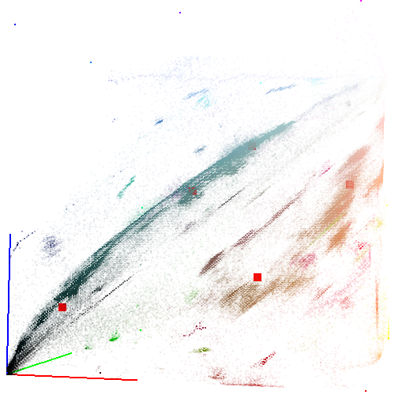
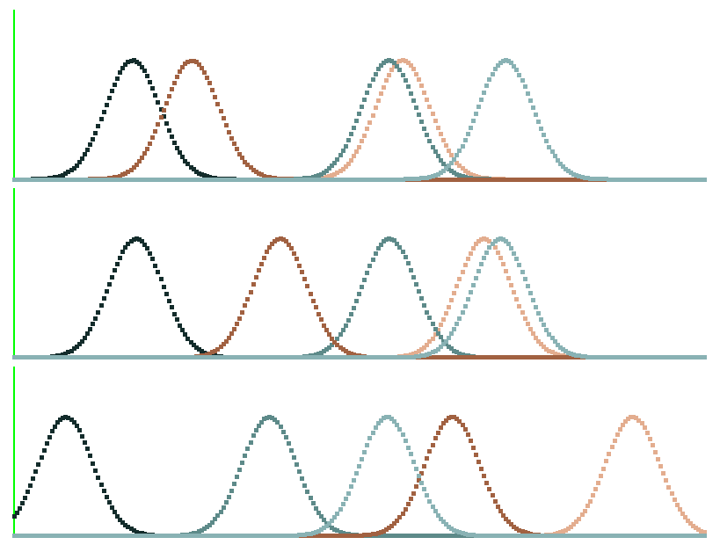
1
Degree of membership
0
B
43
65
137
143
180
1
0
G
44
97
138
173
178
1
0
R
19
93
137
161
227

Slide 2
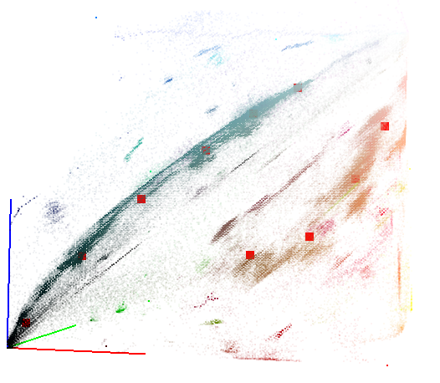
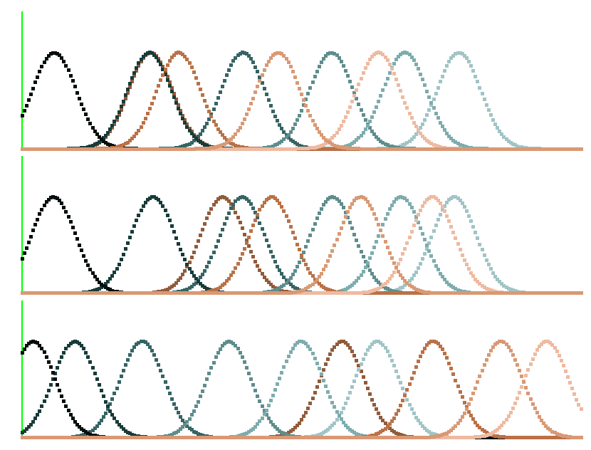
1
Degree of membership
B
0
71
100
116
140
161
173
198
14
57
1
0
G
100
153
172
186
14
59
91
113
141
196
1
0
R
5
23
54
94
126
145
161
186
217
238

Slide 3
Temperature
hot
cold
Wind
Running
100%
Not windy
windy
Tennis
100%
Humidity
strong
weak
Football
100%
Football 50%
Running 50 %

Slide 4
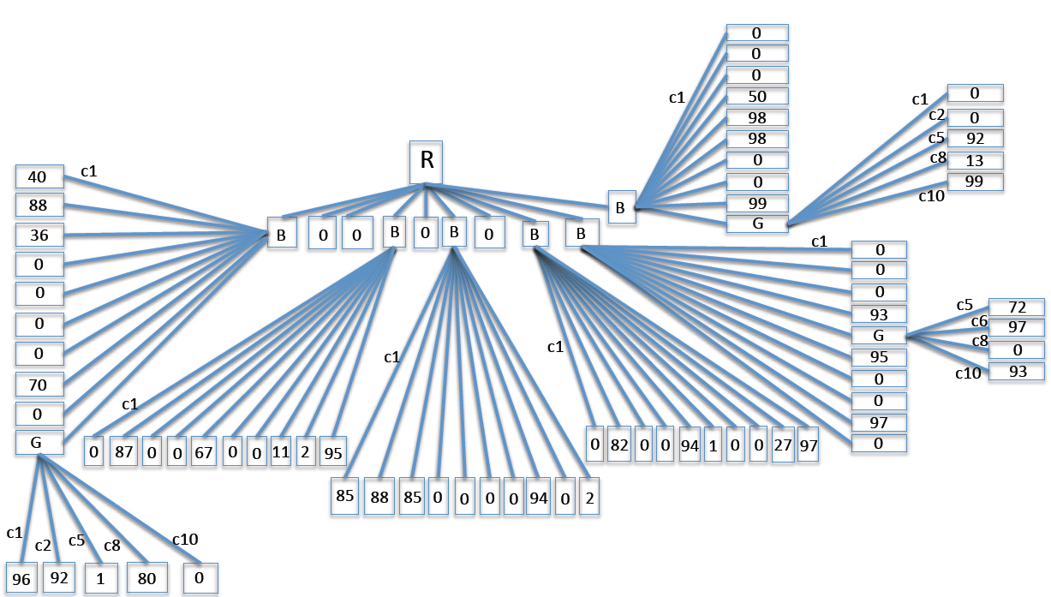
c2
c3
c4
c5
c6
c7
c10
c8
c2
c1
c4
c5
c9
c2
c3
c6
c7
c8
c9
c3
c10
c4
c2
c5
c3
c6
c4
c7
c5
c8
c6
c7
c9
c4
c5
c8
c2
c3
c6
c8
c2
c5
c6
c7
c9
c10
c7
c9
c10
c9
c10
c3
c8
c4
c10
c2
c3
c4
c5
c7
c9
c6
c8
c10

Slide 5
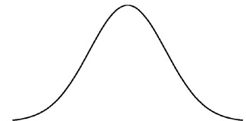







$$σ$$
$$µ$$
$$µ−2σ$$
$$µ −σ/2$$
$$µ+σ/2$$
$$µ+2σ$$
$$f\left(x\right)= \frac{1}{σ\sqrt{2π}}e^{−\frac{1}{2}{(\frac{x−μ}{σ})}^{2}}$$

